Slide 1





COW PANIC!
A Game by CI 102’s Group 1
Notes:
Project manager introduces the group

Slide 2
Team:
THE UDDER GUYS
Jake Carfagno - PM, Developer
Drew Graham – Game Designer, Developer
Joshua Karmel – Artist, Developer
Hugo Armella - Artist, Developer
Dan Sipe - Developer
Jonah Musto - Quality Assurance,
Developer
WHO?!?!?
Notes:
Every member introduces self and gives brief overview of roles

Slide 3
The Game:
Mobile game (Android, Unity)
Player: UFO
Objective: Abduct Cows
Casual & Intense Play
Campaign & Endless Modes
WHAT?!?!?
Notes:
Drew explains the game concept because it was his idea

Slide 4
The Game:
TECHNOLOGY
C#
Unity
GameMaker
WHAT?!?!?
Notes:
Hugo

Slide 5
Scope:
Prototype by week 10
Full game by next term
HOW & WHEN?!?!?
Notes:
Jonah

Slide 6
Scope:
Prototype Features
Touch Controls
Main Menu
Point System
Game Over Conditions
Sprites
Endless Mode
HOW & WHEN?!?!?
Notes:
Dan

Slide 7
Scope:
Extra Time Additions
Save/Load Features
Offline Scoreboard
Cow Variants
HOW & WHEN?!?!?
Notes:
Josh

Slide 8
Scope:
MAIN FEATURES IN
FINAL VERSION
Campaign Mode
Upgrades and Abilities
Final Art Assets (Sprites,
Backgrounds, and Music)
HOW & WHEN?!?!?
Notes:
Jake

Slide 9
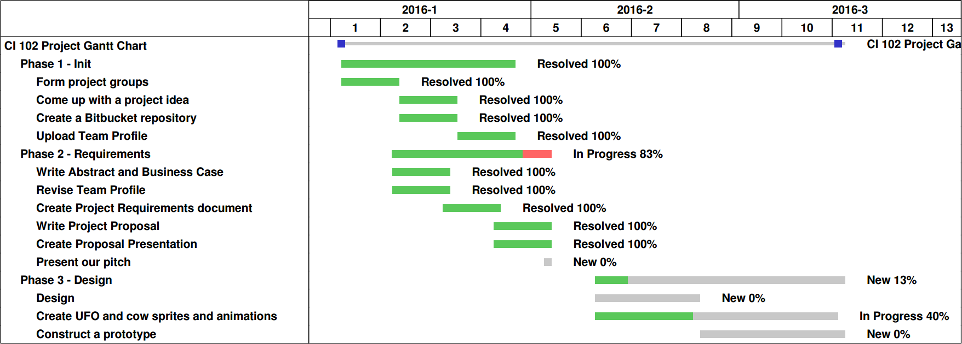
Time:
WHEN?!?!?
Gantt Chart
Notes:
Jake

Slide 10
Works Cited:
Cow Picture
www.clipartpanda.com

